Slide 1

Mobile Application Development, Fall 2021 Using Outside APIs

Slide 2
Today’s Agenda
Refreshing Our Memories, and a New Hook: useEffect
Extracting Hook Logic
Actually Showing Some Restaurants!

Slide 3
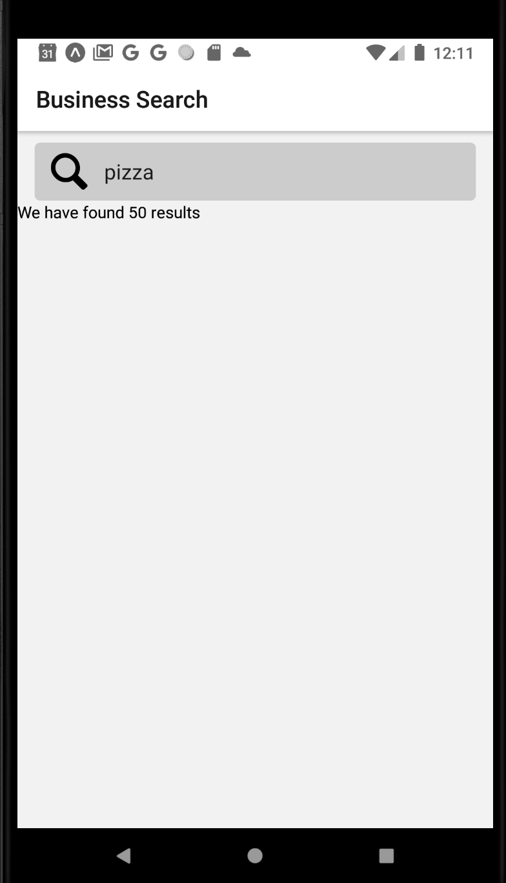
Memories and Hooks
Previously on Mobile Apps…
We had gotten our app to be able to use the Yelp API to fetch lots of New Orleans pizza places!

Slide 4
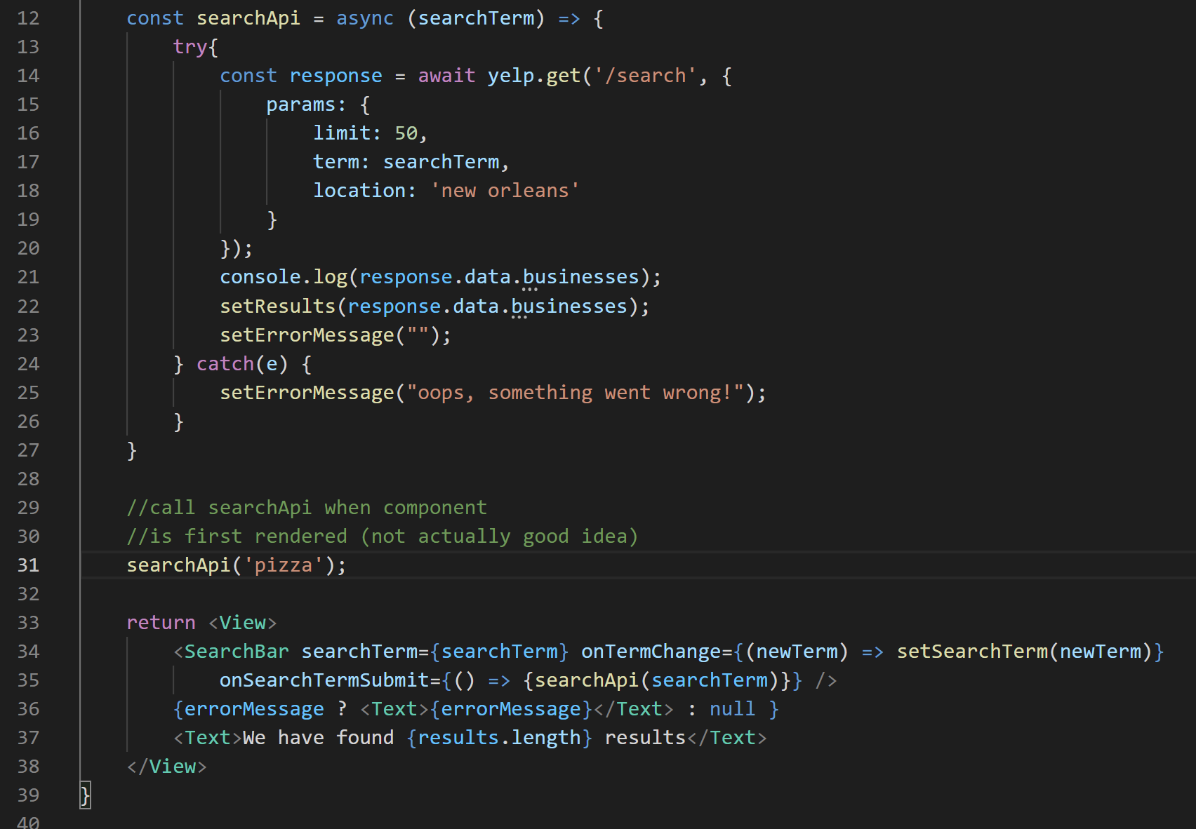

Memories and Hooks
To autopopulate our app screen, we just tried invoking the API function immediately!

Slide 5

Memories and Hooks
But that got us into an infinite loop!
Getting data would have us update the state.
Update the state rerenders the screen.
Re-rendering the screen has us get more data
Getting more data has us update the state.
Forever!

Slide 6
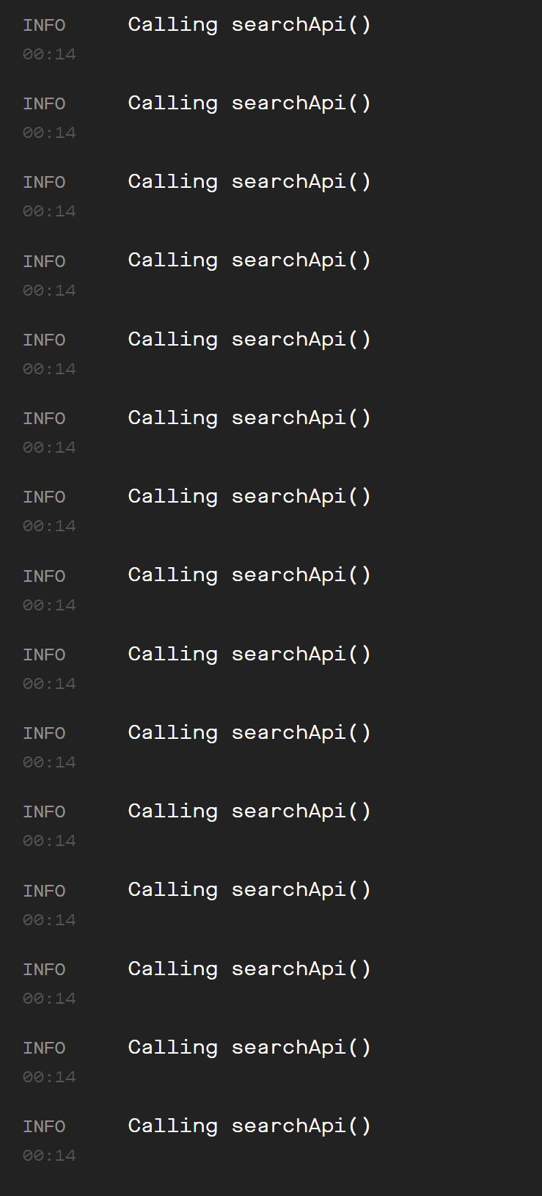
Memories and Hooks
It’s a good way to make Yelp mad at us…
Use up our user’s data plan…
And their phone battery life…
Generally speaking: not a good look for us!

Slide 7
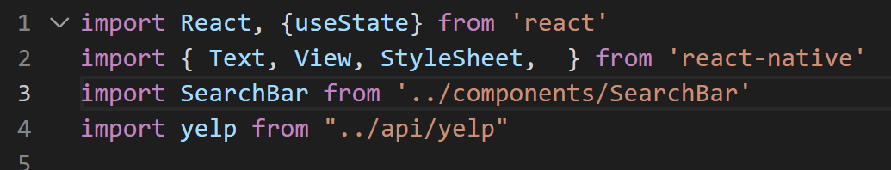
Memories and Hooks
So, let’s chat about a better way to handle this.
It’s going to be a new hook!
Remember, hooks are like useState and useReducer
functions that we import that do some extra functionality for us.

Slide 8
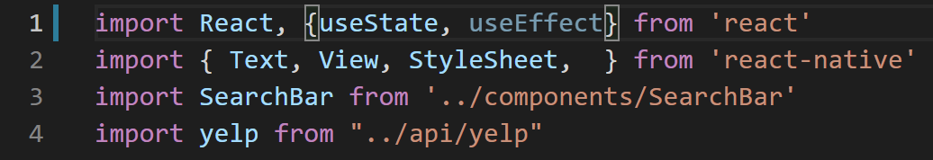

Memories and Hooks
This new hook is called useEffect
Just add it with a comma after useState!

Slide 9
Memories and Hooks
The purpose of useEffect is *very* apropos for our current needs!
useEffect allows us to exert some specific control regarding how many times to run some code when our app first starts up.
How convenient!

Slide 10
Memories and Hooks
The way to do this specification is through the arguments you pass in to useEffect().
There are a few different general forms this will typically take.
The first is this bad boy, where you just pass in a function:
useEffect( () => {} )

Slide 11
Memories and Hooks
If you have this line of code, then the contents in the body of the function will execute EVERY time your app starts.
That’s basically what we have right now, so it’s not what we need!
useEffect( () => {} )

Slide 12
Memories and Hooks
The second is this, where we provide both a function AND an empty array.
When we do this, the body of the function will execute only when the component is FIRST rendered.
This feels much closer to what we want!
useEffect( () => {}, [] )

Slide 13
Memories and Hooks
And then, just for one more…
The third flavor is when we still pass in a function and an array…
But now the arrays have values!
This will have the body of the function execute either when our component FIRST renders…
OR when one of the values in the array changes.
useEffect( () => {}, [value,value] )

Slide 14
Memories and Hooks
That might sound strange, but we’ll see an example of it later!
So we have these three flavors, and we know which one we need for THIS current problem we’re facing. Let’s do it!
useEffect( () => {} )
useEffect( () => {}, [] )
useEffect( () => {}, [value,value] )

Slide 15
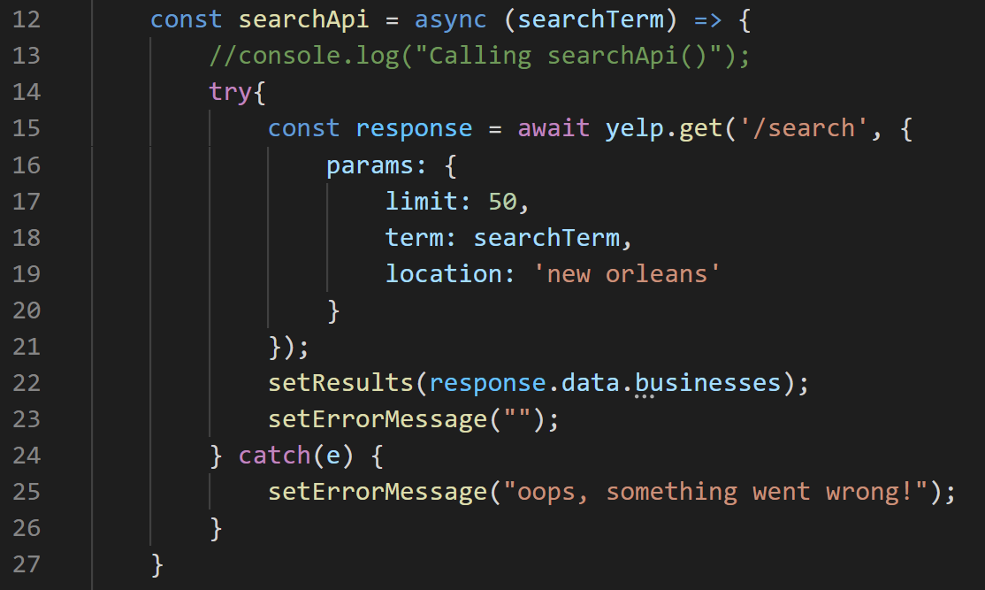
Memories and Hooks
So, jumping back to our code here…
This nice little function is basically what we want to call exactly once, yeah?

Slide 16
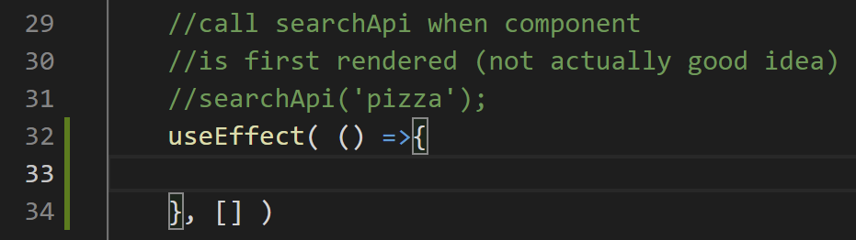

Memories and Hooks
Before we just called it directly (note how it is now commented out).
But now we can make use of useEffect.
Note that we start with an empty arrow function, and an empty array.

Slide 17
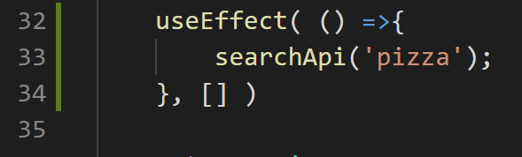
Memories and Hooks
And voila!
We fill the body of our function with a call to our own!

Slide 18
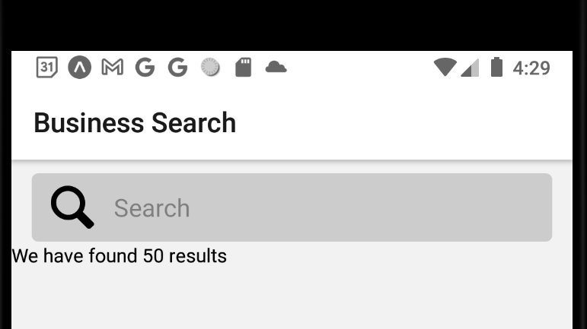
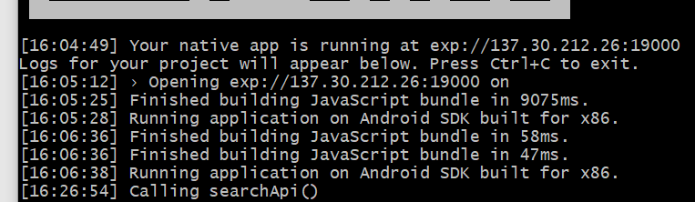
Memories and Hooks
And at this point, we successfully find our 50 pizza places (which we WERE doing before…)
But we do so with only a single call to the API! No infinite loops here!

Slide 19
Today’s Agenda
Refreshing Our Memories, and a New Hook: useEffect
Extracting Hook Logic
Actually Showing Some Restaurants!

Slide 20
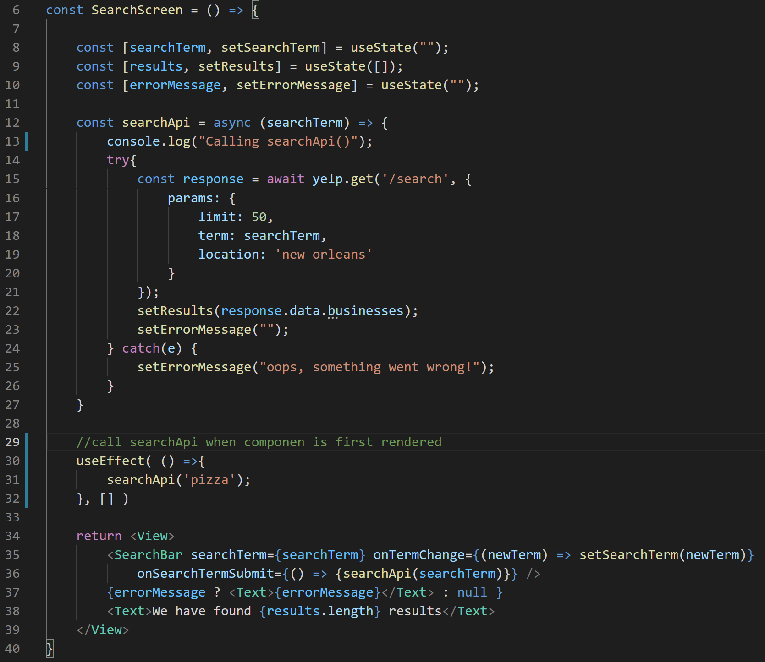
Extracting Hook Logic
So, I know everyone is probably itching to actually start making our restaurants show up.
But we’re going to do one more bit of software-engineering mojo first.

Slide 21
Extracting Hook Logic
Here is everything in our SearchScreen component.
You can see it’s getting kind of large!

Slide 22

Extracting Hook Logic
But a lot of it isn’t even necessarily connected to the SearchScreen.
There’s just kind of a lot of business logic in here, that we happen to be using for the search screen.

Slide 23
Extracting Hook Logic
As it turns out, one of the advantages of using hooks is that it makes it easier to separate some of these pieces out from one another.
And still have them be usable throughout our whole application.

Slide 24
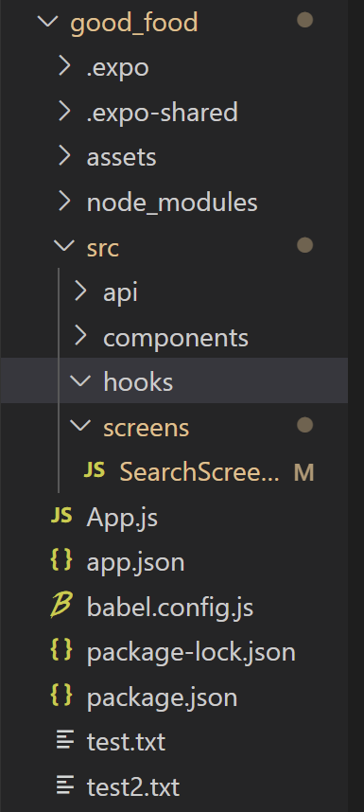

Extracting Hook Logic
To do this, we’ll need some new files.
And we’ll store them in a new folder.
Put this folder in your src directory, and call it ‘hooks’

Slide 25
Extracting Hook Logic
Technically, as we go through this process of extracting out hook-related content in a separate file…
That’s us making hooks of our very own!
Remember: a hook is just a function that adds extra functionality to our components.

Slide 26
Extracting Hook Logic
The naming convention for hooks, as we’ve seen is:
The word “use”
And then some term that describes what resource, or thing, this function is going to help us with.
Given that we’re going to be extracting code that helps us deal with results from the Yelp API, what might be a good name for this hook?

Slide 27
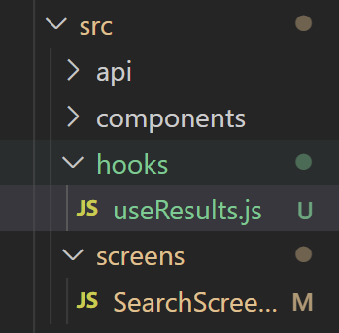

Extracting Hook Logic
Perhaps “useResults.js”
As we are retrieving the results from the API, and this hook will handle how to use them.
To get this started, we’ll need to import several things.

Slide 28
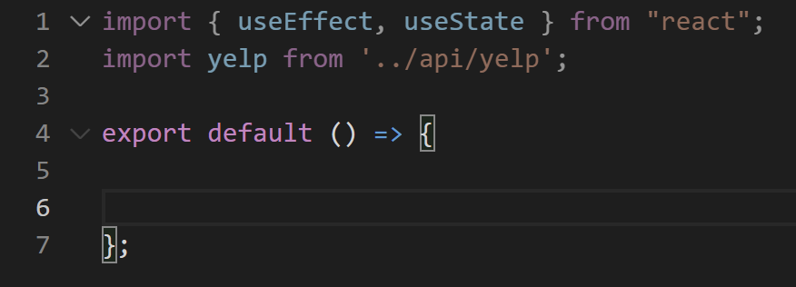
Extracting Hook Logic
Namely, the hooks we’ve been using before (useEffect, and useState)
And also our instance of our yelp API that we made before.
That export default () => { } might look a little new, but it isn’t so bad.
Basically, it is combining our ‘functional component declaration’ line and our ‘export line’ into one.

Slide 29
Extracting Hook Logic
Now, this next part might be a little tricky…
Let’s start by basically copy and pasting everything pertaining to search functionality OUT of the old SearchScreen and into here
But we’ll leave the JSX behind.

Slide 30

Extracting Hook Logic
So that’s like, all of this stuff, right?

Slide 31
Extracting Hook Logic
It might feel weird that we’re leaving this part out.
Although it’s true, the Yelp API needs that to work correctly… It isn’t *directly* connected to it.
Unlike, say, how invoking searchApi directly sends a request to the API…
And the results variable stores what we get back from the API.

Slide 32
Extracting Hook Logic
It might feel weird that we’re leaving this part out.
Although it’s true, the Yelp API needs that to work correctly… It isn’t *directly* connected to it.
Unlike, say, how invoking searchApi directly sends a request to the API…
And the results variable stores what we get back from the API.

Slide 33
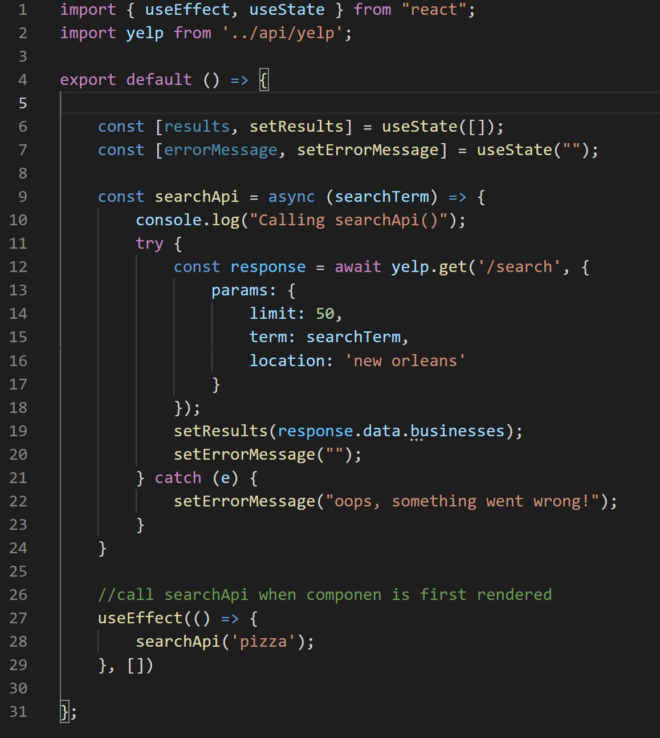
Extracting Hook Logic
So when we cut that stuff out from SearchScreen.js, and add it to our new hook, useResults.js…
It looks like this!

Slide 34
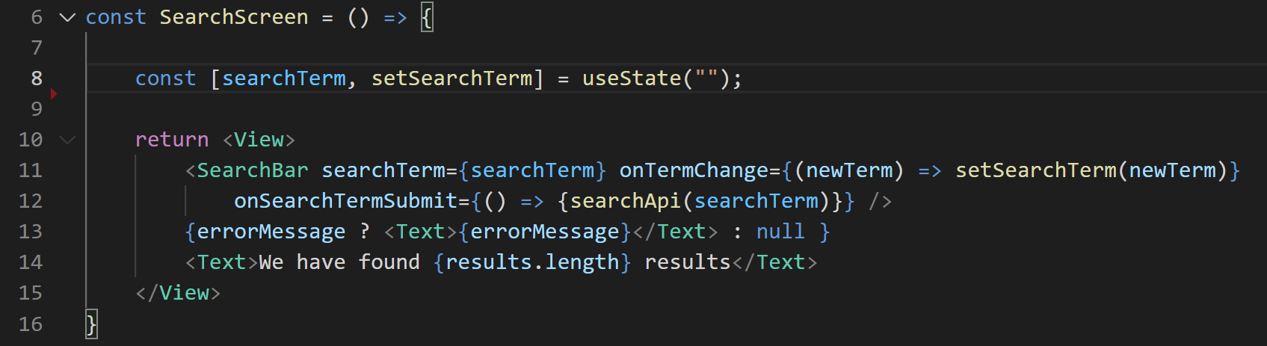
Extracting Hook Logic
But let’s go back to SearchScreen.js
It is looking much more svelte now.
BUT – it’s using things that we just moved!

Slide 35
Extracting Hook Logic
We don’t have that searchApi function here anymore…
Nor do we have the errorMessage bit of state…
Or the results!

Slide 36
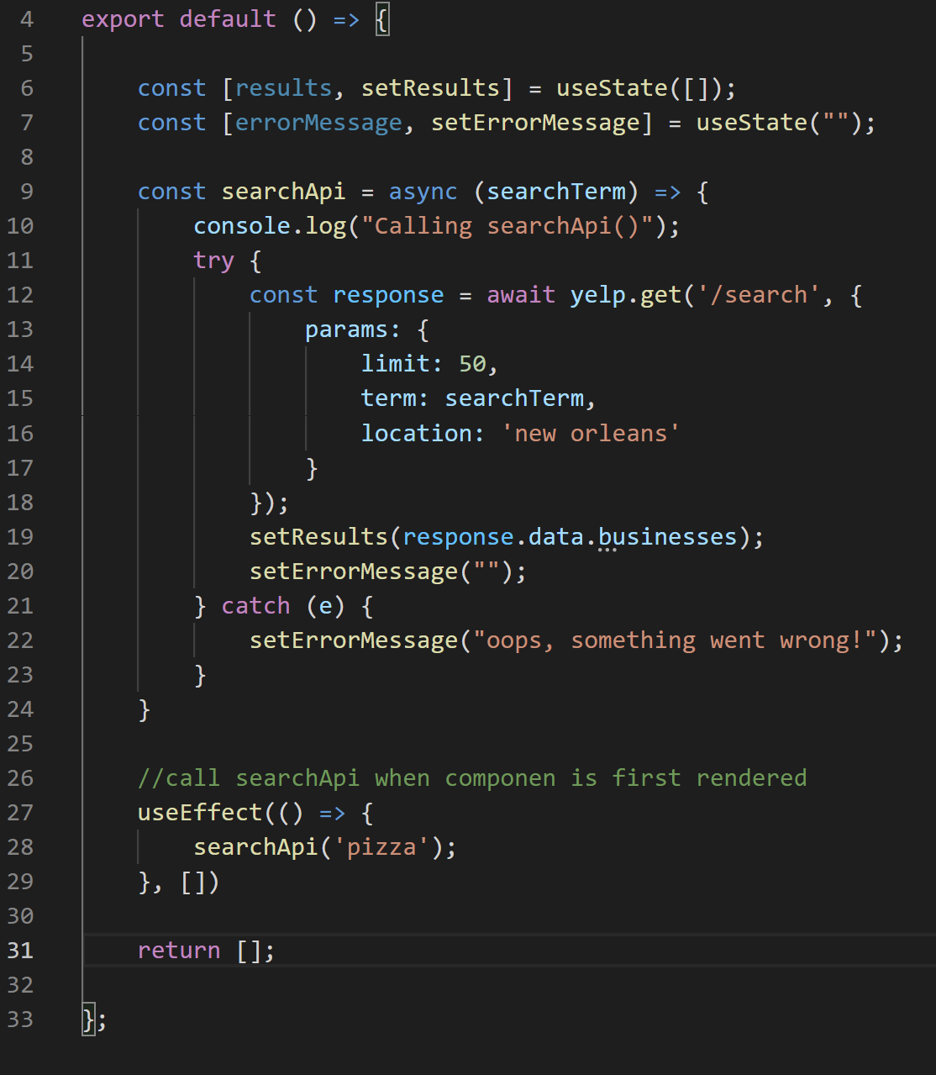
Extracting Hook Logic
We need those things in SearchScreen.js, but we just made all of them live in useResults.js
So… what we can do is return those specific things from our new useResults.js file
We’ll return them all in an array.
useResults.js

Slide 37
Extracting Hook Logic
Remember the things we needed?
The searchApi function…
The results from the Yelp API….
And the error message.
useResults.js

Slide 38
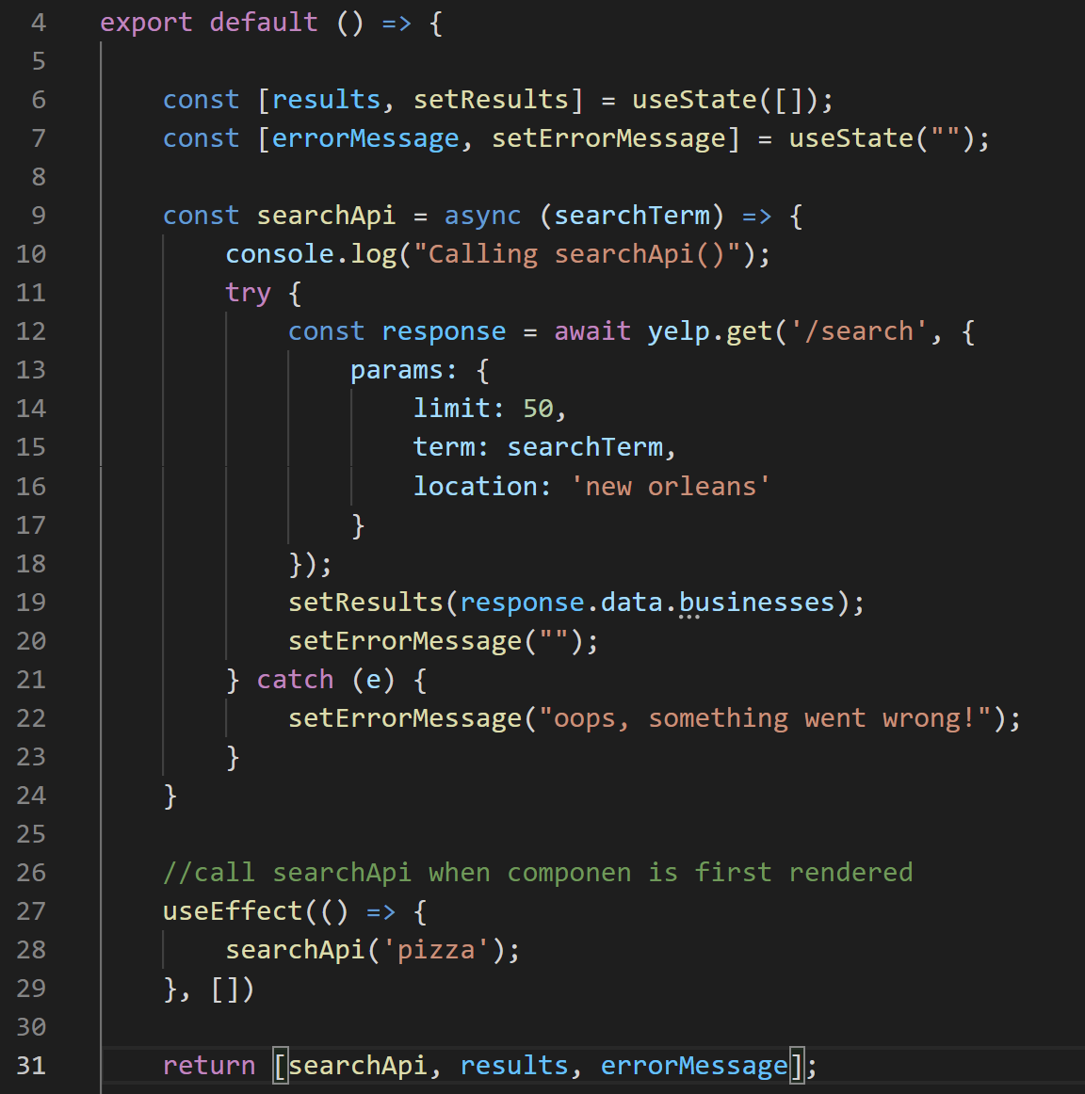

Extracting Hook Logic
Well, let’s just return those things then in our array!
Easy as pie!
NOW.. I’m curious… does this strike anyone as familiar….???
Have we seen or worked with stuff LIKE this before…????
useResults.js

Slide 39
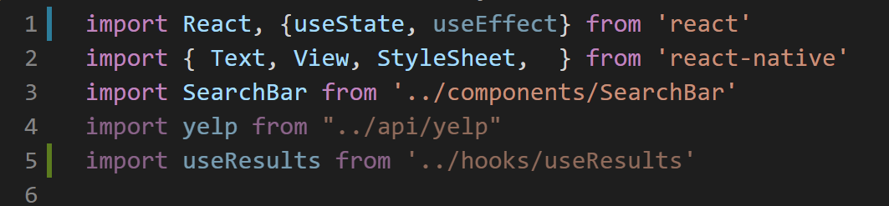
Extracting Hook Logic
Let’s go back to our SearchScreen.js…
And we’ll import the new hook that we just created…
Ehhh??? EHHHH???????
Feeling FAMILIAR????
SearchScreen.js

Slide 40
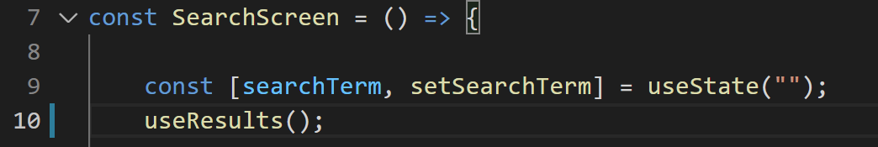
Extracting Hook Logic
SearchScreen.js
We know that we want to invoke this new hook we just imported…
But what does it return?
It returns an array!
JUST LIKE ALL OF THE OTHER HOOKS WE’VE BEEN USING!!!

Slide 41
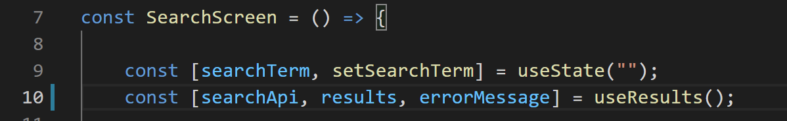
Extracting Hook Logic
SearchScreen.js
useResults() returns an array…
And we can just destructure it like we’ve been doing!
So the three things we return in our useResults hook, now get stored in these three new variables!

Slide 42
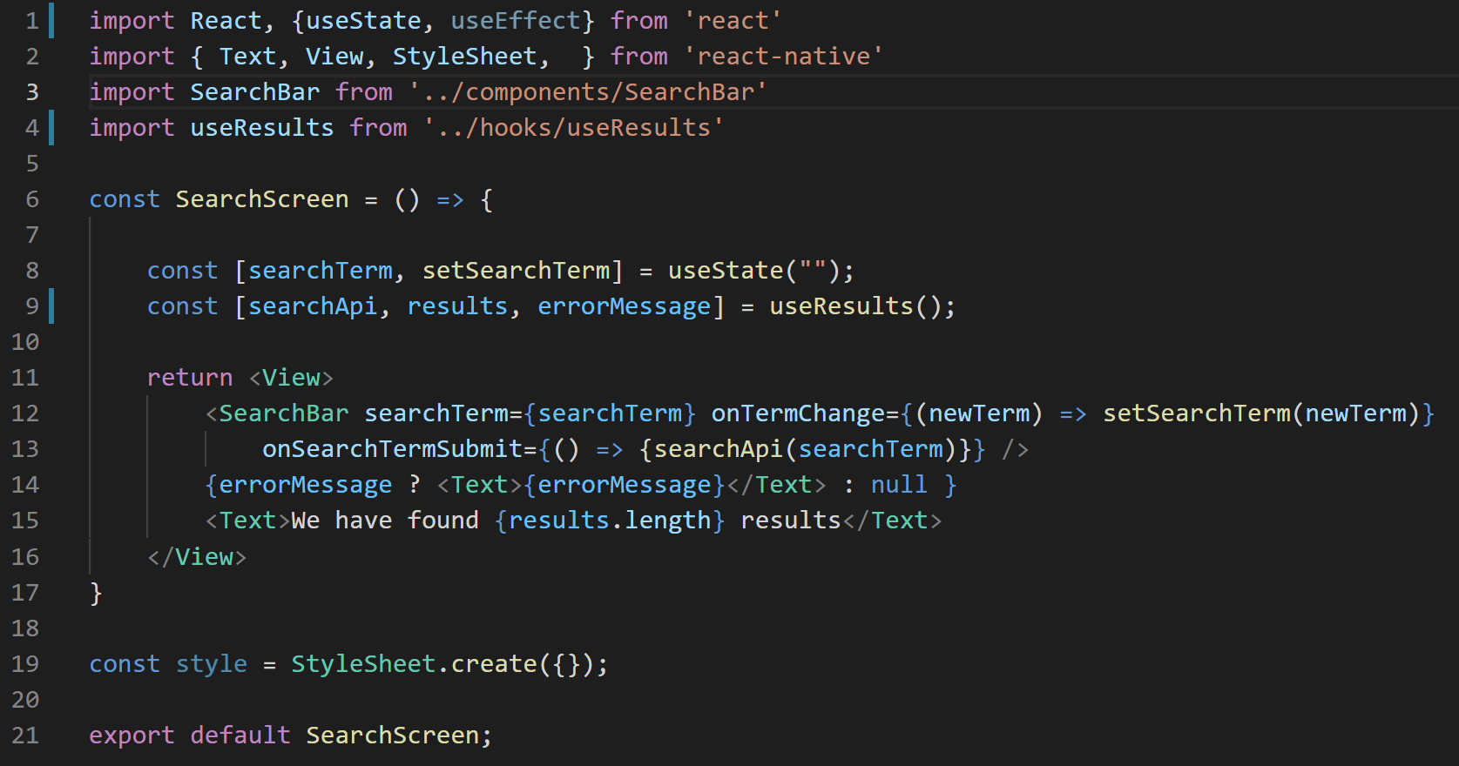
Extracting Hook Logic
And now look at how beautiful this screen is!
SearchScreen.js

Slide 43
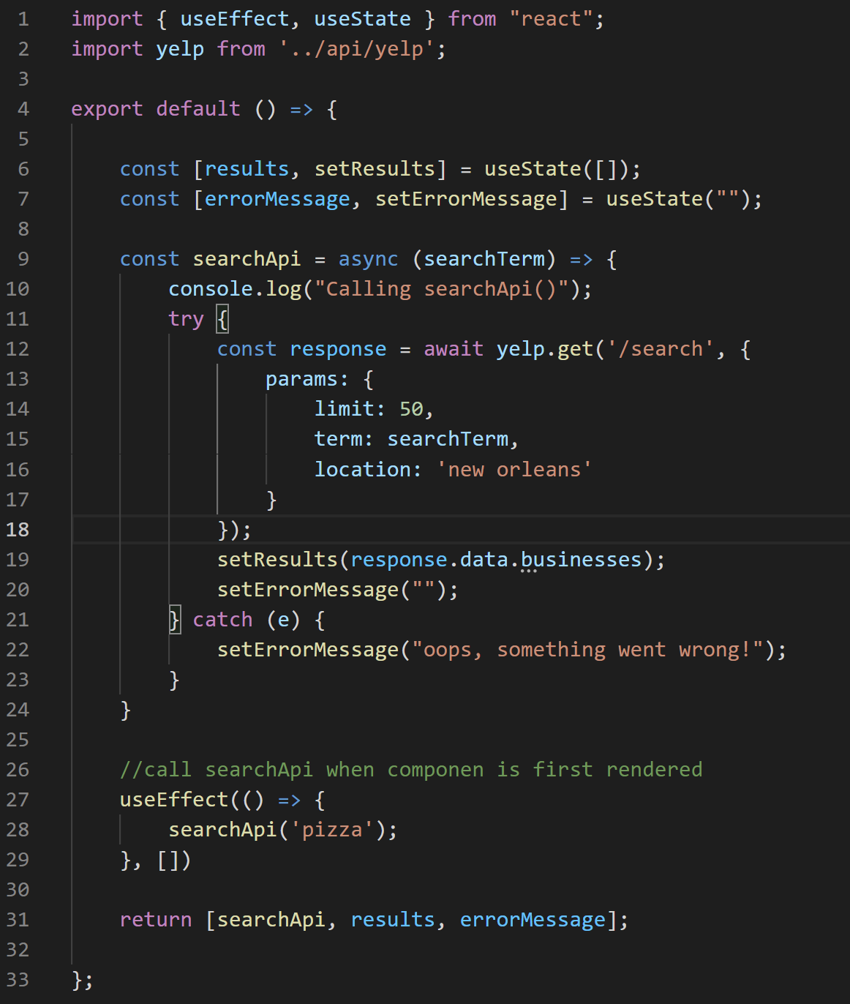
Extracting Hook Logic
And now look at how VERSATILE this screen is!
We can now easily re-use all of this code in any other file of our app as well!
useResults.js

Slide 44
Extracting Hook Logic
Hopefully that felt pretty good!
But we’ll be making more custom hooks of our own moving forward, so we’ll see plenty more examples!
useResults.js

Slide 45
Today’s Agenda
Refreshing Our Memories, and a New Hook: useEffect
Extracting Hook Logic
Actually Showing Some Restaurants!

Slide 46

Showing Restaurants
Search Bar!
$ Restaurants
Picture
Picture
Remember, oh so long ago…
This was the goal that we had set for ourselves!
An app that didn’t just GET Yelp data, but actually displayed it in a nice way.
Name
Name
Rating
Rev. #
Rating
Rev. #
$$ Restaurants
Picture
Picture
Name
Name
Rating
Rev. #
Rating
Rev. #
$$$ Restaurants
Picture
Picture
Name
Name
Rating
Rev. #
Rating
Rev. #

Slide 47
Showing Restaurants
Search Bar!
SearchBar
$ Restaurants
Picture
Picture
And we decided that we could have both a “SearchBar” component, and a RestaurantList component.
We’ve been in Search land for a while now. Let’s list some restaurants!
Name
Name
Rating
Rev. #
Rating
Rev. #
$$ Restaurants
Picture
Picture
RestaurantList
Name
Name
Rating
Rev. #
Rating
Rev. #
$$$ Restaurants
Picture
Picture
Name
Name
Rating
Rev. #
Rating
Rev. #

Slide 48
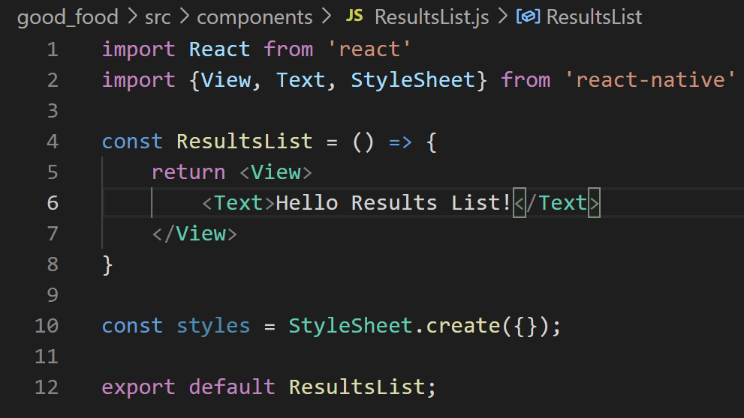
Showing Restaurants
Specifically, let’s make a new reusable component called ResultsList.js
(We could have called it RestaurantList.js of course, but we’ve been calling what we get back from Yelp ‘results’ everywhere else, so we’re just being consistent here).
And you know, feel free to give it all the good default stuff!
ResultsList.js

Slide 49
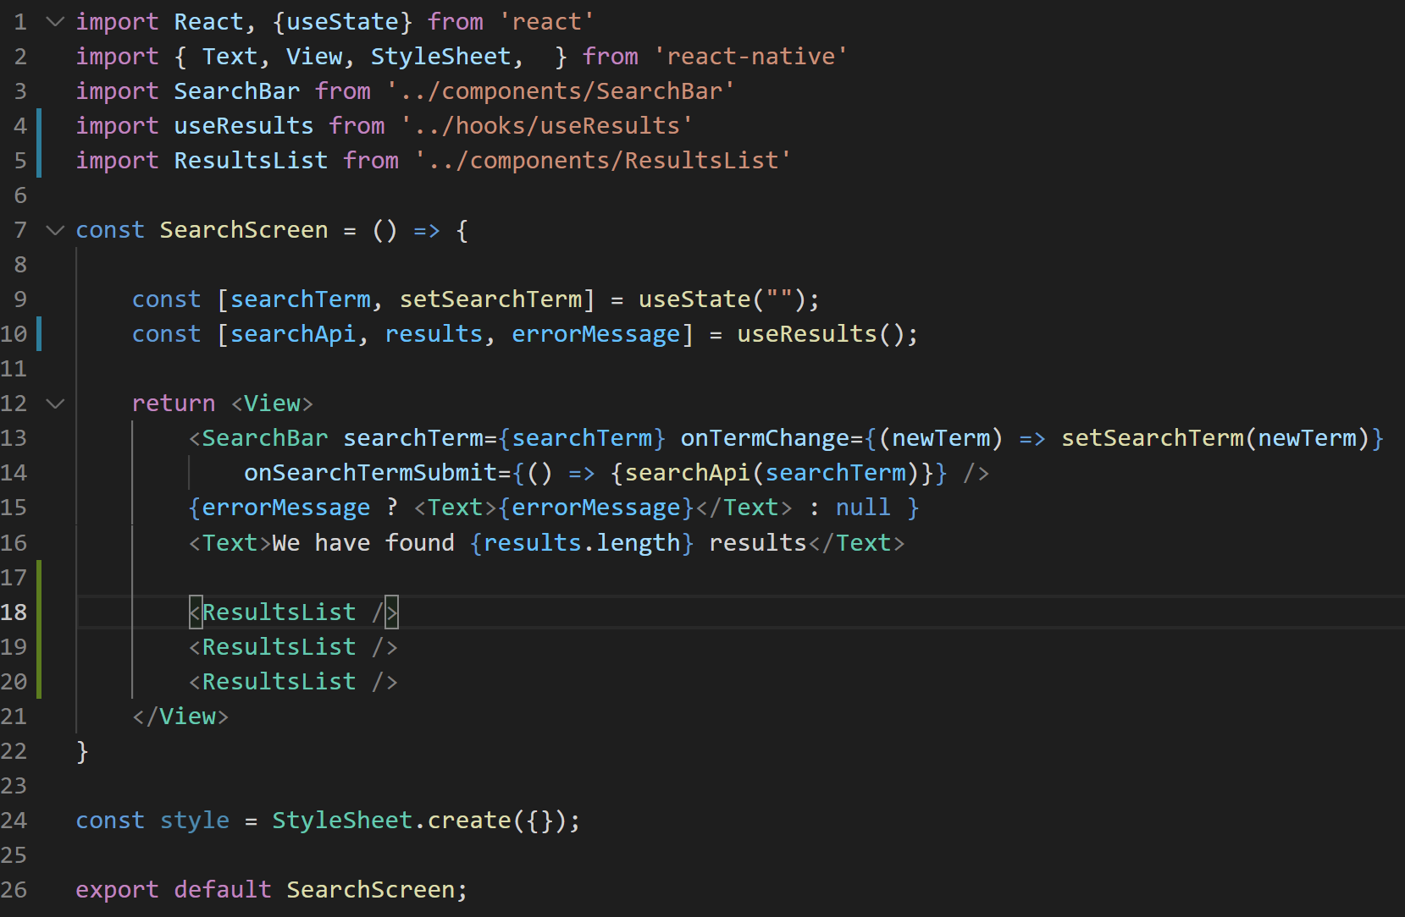

Showing Restaurants
And then we can make use of that shiny new reusable component in our SearchScreen.js
We can simply import it…
And then add it to our JSX a few times!
SearchScreen.js

Slide 50
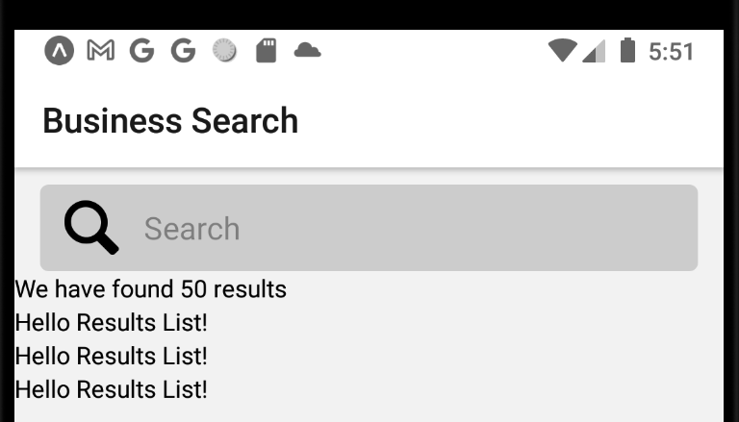
Showing Restaurants
And indeed, doing so gets us this lovely little screen!
We’ve got three results list!
Now we just need to make them better!

Slide 51
Showing Restaurants
Now, as you might guess, those ResultsList components are looking mighty empty.
We’ll want to fill those in with props, for sure, to customize each list with different data!
Also, each list had a different header, which we can pass down too.
SearchScreen.js

Slide 52
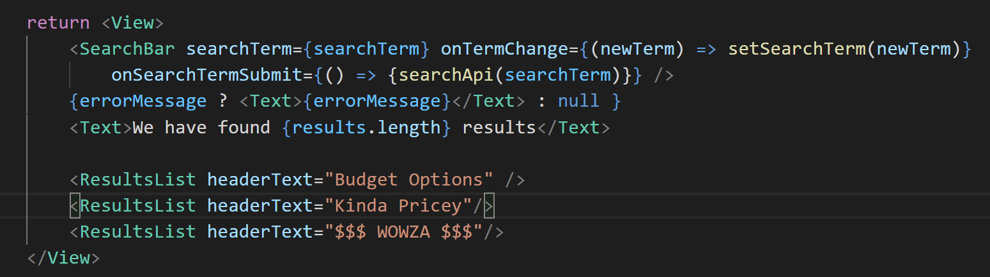
Showing Restaurants
SearchScreen.js
Here, we gave our props the name ‘headerText’ and passed down an appropriate string for each one…

Slide 53
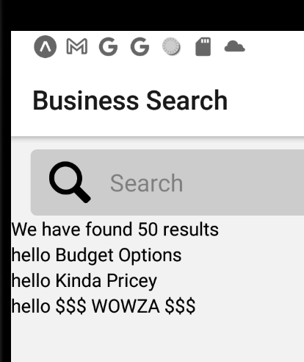
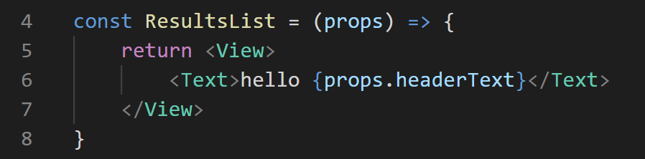
Showing Restaurants
And then we just make sure we make use of those in our resultList component…
And indeed, we now have headers for each list. Lovely.
ResultsList.js

Slide 54
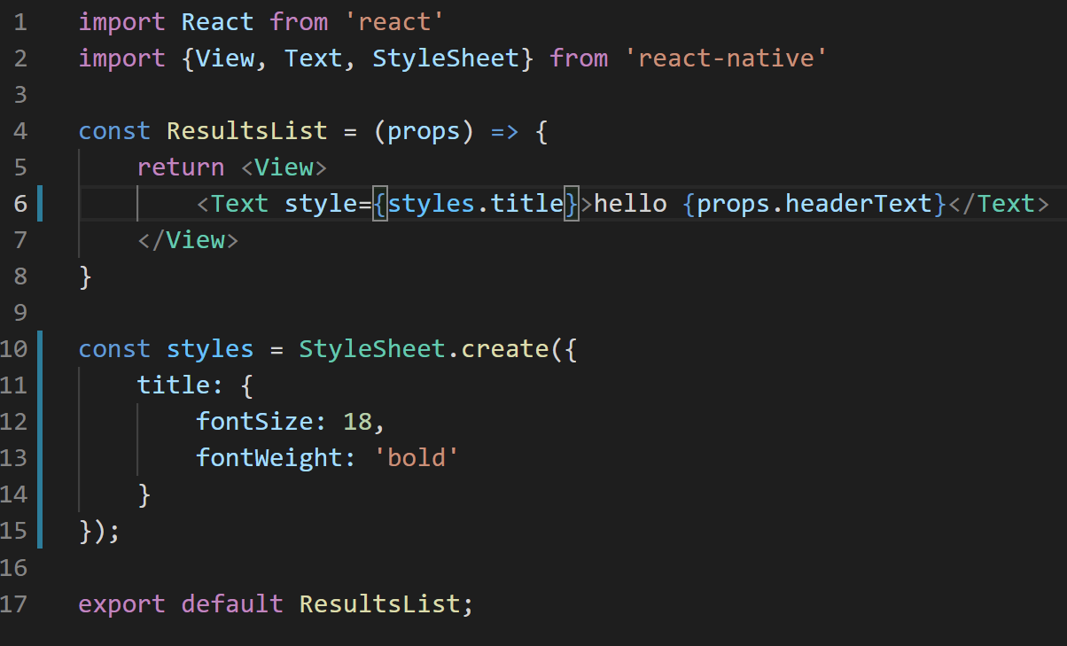
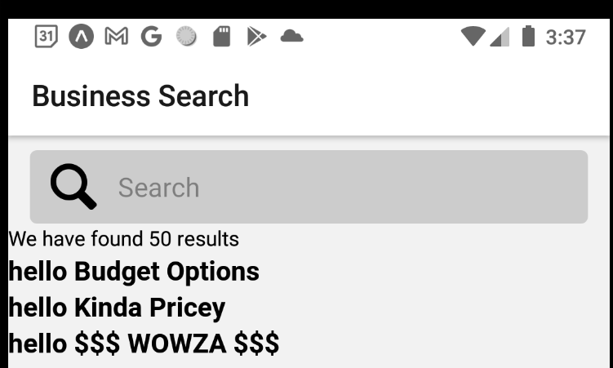
Showing Restaurants
And while we’re at it, we can throw in some styling as well!
Now our headers just stand out a little more!
ResultsList.js

Slide 55
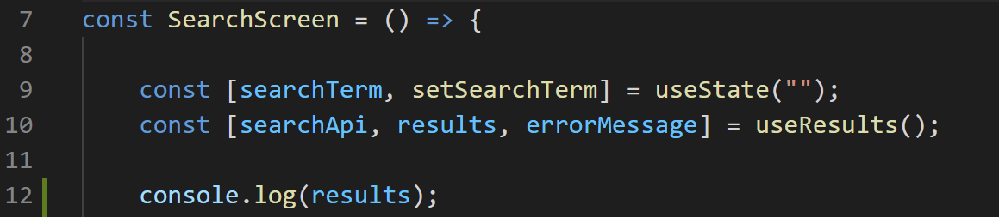
Showing Restaurants
OK – we’re finally at the point where we are ready to start actually filling in our app with some pretty pictures!
Before we do, let’s super fast remind ourselves what our data looks like.
If we print out our search results…
SearchScreen.js

Slide 56
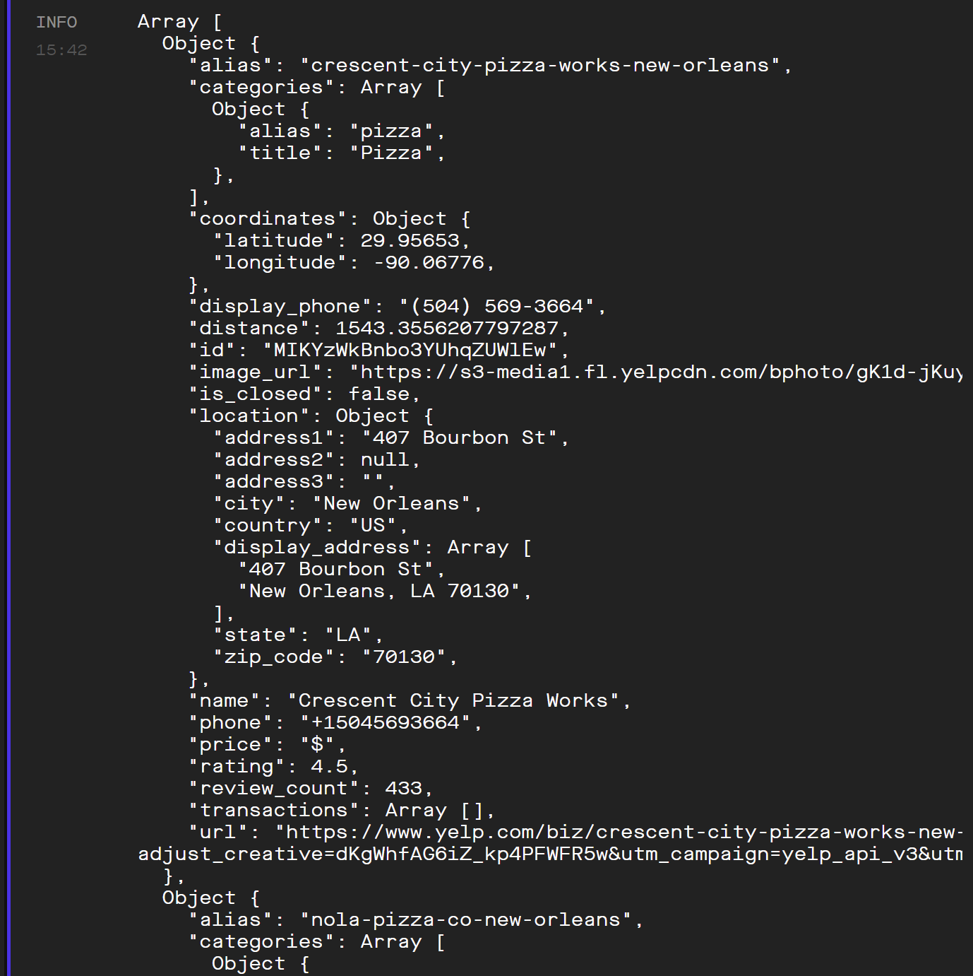

Showing Restaurants
We’ll see something that looks like this.
A big array.
Where every element in the array represents a different business.
ResultsList.js

Slide 57

Showing Restaurants
There’s a ton of useful properties in each object.
But what we’ve decided we’re going to categorize our information by is PRICE.
So that one is extra useful to us at the moment!
ResultsList.js

Slide 58
Showing Restaurants
Note that in Yelp-land, they measure price by dollar signs.
$ == inexpensive
$$$$ == max expensive
ResultsList.js

Slide 59
Showing Restaurants
So we need to write some logic to group like restaurants together.
That is, get all of the $ restaurants bunched up, all of the $$ restaurants bunched up, etc.
The question is: where should that logic go?
ResultsList.js

Slide 60
Showing Restaurants
SearchScreen
One option is to do it in SearchScreen.js
We do all the filtering logic in the parent component…
And then we pass the specific lists down into our ResultsList components.
results
'$’ results
'$$’ results
'$$$’ results
ResultsList
ResultsList
ResultsList

Slide 61
Showing Restaurants
SearchScreen
A second option is to have the individual ResultsList be responsible for filtering.
In this world, we pass down ALL results to each individual ResultsList.
As well as a message teaching the ResultsList what it should filter for.
results
results
results
results
'please find $
'please find $$
'please find $$$
ResultsList
ResultsList
ResultsList

Slide 62
Showing Restaurants
Both of these options would work just great!
Does one leap out to you over the other as a better one?

Slide 63
Showing Restaurants
SearchScreen
We’re gonna go with option 1: passing in pre-filtered data.
The general convention is when you have a component like ResultsList, it shouldn’t be responsible for doing any data filtering.
All it should worry about is: I’m going to display everything that got handed to me!
results
'$’ results
'$$’ results
'$$$’ results
ResultsList
ResultsList
ResultsList

Slide 64
Showing Restaurants
Great! We’ve decided on where we’re writing the code!
Now it’s just a matter of writing it! Fun!
This is a fun mind’s eye moment. Before we write it together, how would you perform such a filtering?

Slide 65
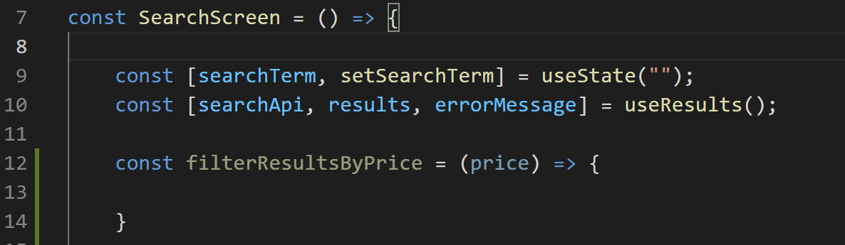
Showing Restaurants
What if I gave you this as a clue?
We’ll write a little helper function inside of SearchScreen…
And it takes in an argument that represents the current price we are trying to match.
SearchScreen.js

Slide 66
Showing Restaurants
What if I gave you one last clue…
Arrays in JavaScript have a nifty built-in function that you can just use for free, called filter.
It takes as input a function
That function then gets called on every element in the array.
And that function should return a Boolean value, true or false
The filter function produces a new array, full of every element for which the “input function” returned true.

Slide 67
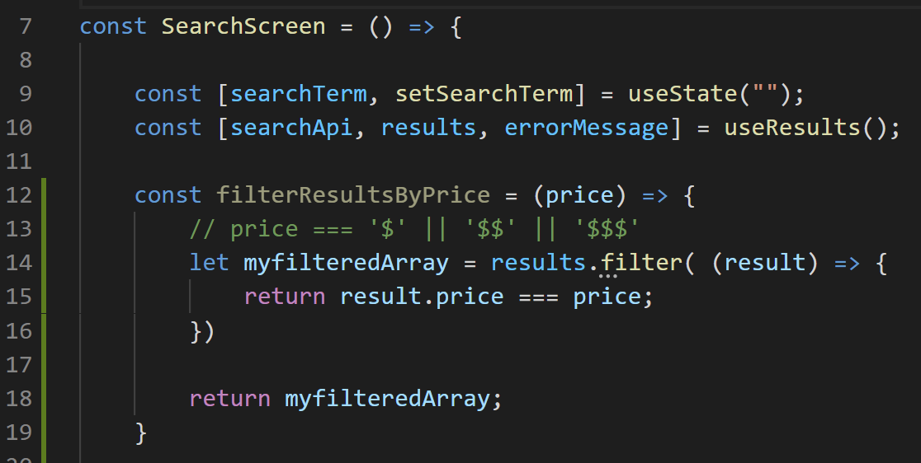
Showing Restaurants
PHEW. Kinda hard to picture it with just words, but, take a look!
So, recall, results is that array full of business we were just looking at.
SearchScreen.js

Slide 68
Showing Restaurants
What we are talking about is how in JavaScript, arrays have a function called filter.
So this is us calling that function on that results array.
SearchScreen.js

Slide 69
Showing Restaurants
The filter function wants as input a function itself.
That’s what we’re giving it here.
SearchScreen.js

Slide 70
Showing Restaurants
The function we give it can take in an argument.
We can give the parameter any name we want. Since each element of our array is a “result”, we called our parameter result.
This is going to represent the current ‘element’ of the array that we are looking at.
SearchScreen.js

Slide 71
Showing Restaurants
And the function should return a Boolean value, true or false.
Here, we are checking to see if the price of the current business matches the price we are filtering for.
SearchScreen.js

Slide 72
Showing Restaurants
That function we pass in to filter will get called on *every* element in the results array.
And filter returns a *new* array, full of all of the elements for which our function returned true.
SearchScreen.js

Slide 73

Showing Restaurants
If results had the data as specified here:
And we were filtering on ‘$’
The function gets called on “pizza delicious” –
The filter matches, so we return true.
function called on pizza Domenica
Filter doesn’t match, return false.
function called on Homegrown Pizza
Filter matches, return true.
SearchScreen.js
Imagine results was:
[
{name: “pizza delicious”, price: “$”},
{name: “pizza Domenica”, price: “$$”},
{ name: “Homegrown Pizza”, price: “$”
]

Slide 74
Showing Restaurants
So that means that our new array that our call to filter returns would have two elements
pizza delicious
homegrown pizza
And that we then store that new array inside of myFitleredArray.
Which we then return at the end of our helper function.
SearchScreen.js
Imagine results was:
[
{name: “pizza delicious”, price: “$”},
{name: “pizza Domenica”, price: “$$”},
{ name: “Homegrown Pizza”, price: “$”
]

Slide 75
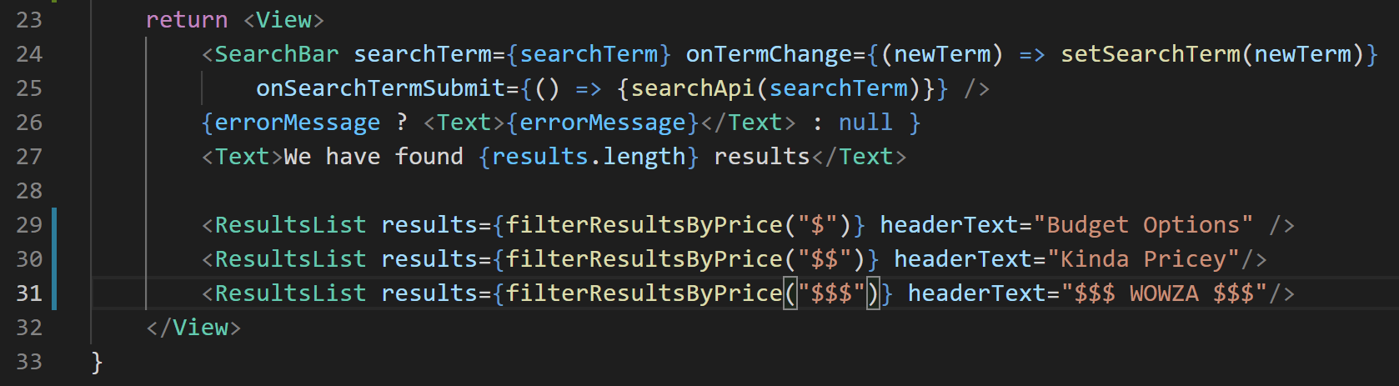
Showing Restaurants
SearchScreen.js
And now that we have that, passing down the filtered data should be really easy!
We just pass in a new prop to our ResultsList components (which I’m calling results here).
And the value of that prop will be the array that we get by doing our various price filters!

Slide 76
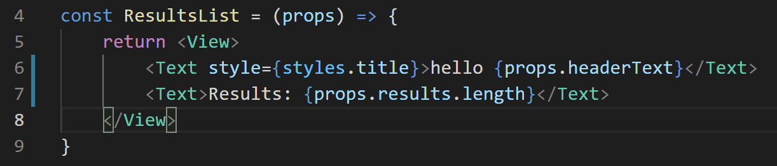
Showing Restaurants
ResultsScreen.js
And just as a quick way to verify that the ResultsList component is getting that data…
We can print out the length of the array that is passed in…

Slide 77
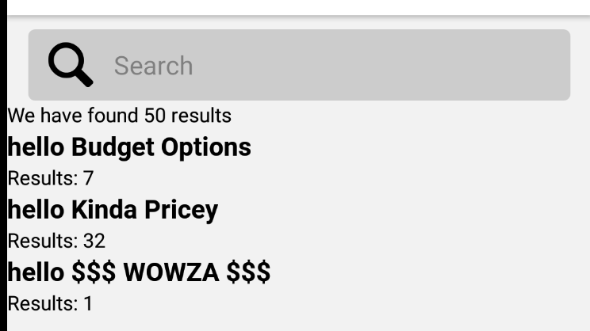
Showing Restaurants
ResultsScreen.js
And verify we’ve got some businesses of all options!
Remember: Yelp goes up to 4 dollar signs. So presumably there are 10 $$$$ pizza places in our New Orleans pizza search!

Slide 78
Showing Restaurants
Lovely! At this point, we have a bunch of restaurants, all filtered!
And of course, we want each of these ResultsList to actually *show* a list of restaurants!
And there’s, heh, only one way we’ve discussed in class about how to get a list of data to display!

Slide 79
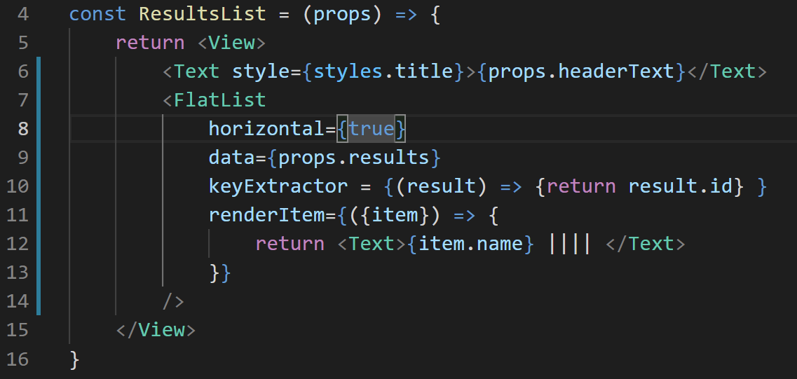
Showing Restaurants
It’s time to bring back our old friend FlatList.
It had all sorts of props associated with it!
horizontal makes it display horizontally, not vertically!
And data is the array full of things we wish to populate the list!

Slide 80
Showing Restaurants
keyExtractor was the performance optimization prop!
It is a function that’s called on each element of data in our list (referenced in the parameter, here result).
And it returns a string that is unique and won’t change.
Here, we are using the Yelp id that is associated with the business.

Slide 81
Showing Restaurants
And then renderItem is how we actually want our restaurants to display!
Remember: the ‘default’ thing we get from renderItem has extra meta-data, so we destructure item, which is the actual element.
And for now, we’ll just print out the name (with some |||| so that they are separated).

Slide 82
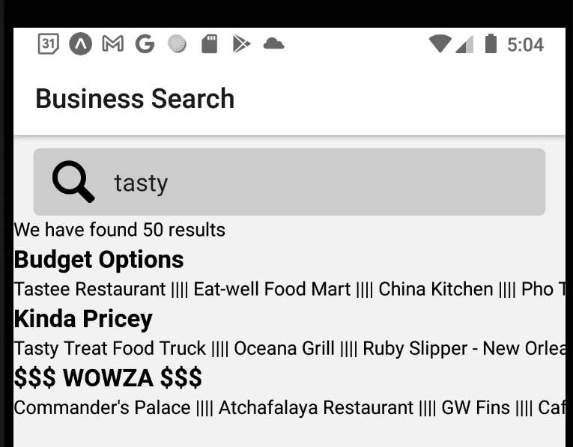
Showing Restaurants
And now, we’ll get something that looks a bit like this!
I did a general search for “tasty” restaurants.
The “Eat-well Food Mart” is a $
“Ruby Slipper” is a $$
“Commander’s Palace” is a $$$
Sounds about right!
Also, these lists are scrollable!

Slide 83
Showing Restaurants
SO – OK!
Still no pretty pictures yet.
BUT! We are definitely getting closer!
If we haven’t already: let’s collectively check in about HW2 and the midterm!

